Slide 1
Backtest Strategy Platform
A Financial Back-Testing and Portfolio Optimization Framework
Course: CS 5001 - Senior Design Fall 2025

Slide 2
Team Members & Advisor
Jash Dedhia (dedhiaja@mail.uc.edu)
Omkar Sontake (sontakor@mail.uc.edu)
Advisor: Hrishikesh Bhide (bhidehk@ucmail.uc.edu)

Slide 3
Project Abstract
Our project is a financial back-testing and portfolio optimization framework designed to let users test trading ideas on historical datasets and analyze outcomes using metrics and charts.
The system integrates user stories such as loading data, defining trading rules, and generating realistic results by accounting for factors like slippage and fees.
This educational tool strengthens our technical skills in quantitative finance, algorithmic trading, and software design while promoting accessible and ethical financial learning.

Slide 4
User Stories
As a student analyst, I want to load historical price data for testing.
As a developer, I want to define buy/sell rules and evaluate strategies.
As a classmate, I want realistic assumptions (fees, slippage) applied.
As a student, I want metrics (CAGR, Sharpe, max drawdown) and charts.
As a teammate, I want results saved in CSV/plots for replication.

Slide 5


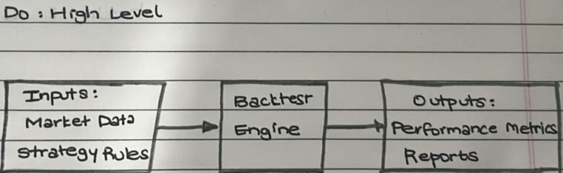

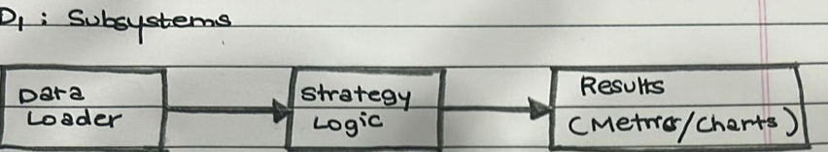
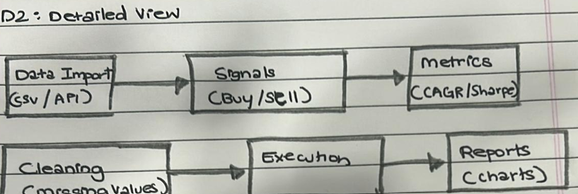
Design Diagrams
D0: Overall backtest engine (inputs → outputs)
D1: Subsystems: Data Loader → Strategy Logic → Results
D2: Detailed modules: Data Import & Cleaning, Signals & Execution, Metrics & Reports

Slide 6
Major Project Constraints
Technical: Use Pandas, NumPy, Matplotlib in Python.
Professional: Coding, documentation, teamwork.
Ethical: Educational only, no investment advice.
Legal/Security: Respect data rights, secure handling.
Environmental/Social: Digital-only project, supports open learning.

Slide 7
Review of Project Progress
Completed: Requirement gathering, user stories, design diagrams.
In Progress: Data cleaning, framework design (Nov–Dec 2025 milestones).
Upcoming: Backtest engine development (Feb 2026), optimization (Mar 2026).

Slide 8
Expected Accomplishments (End of Term)
Working prototype of the back-test engine.
Integration of trading rules with results output.
Early portfolio optimization module draft.
Documentation of assumptions and progress.

Slide 9
Division of Work
Omkar: System design, trade simulation logic, architecture.
Jash: Data collection, cleaning, testing, validation.
Shared: Optimization module, documentation, final presentation.

Slide 10
Expected Demo at Expo
Load sample financial dataset.
Define strategy rules (buy/sell).
Run a backtest simulation.
Display metrics and equity curve.
Preview optimization module (Sharpe ratio or mean-variance).

